Slide 1


Predicting customer loan default
Cameron Pick

Slide 2
Preliminary
Background-Loans that are in default are expensive and a headache to collect. Thus, banks and such need to be cautious on who they give loans to.
Problem-Having too many loan defaults can have severe consequences for a bank. Banks usually have oversight to make sure the company is doing well and not having defaulted loans. With, the business problem at hand is there a way to predict if a loan will default? What factors lead to a default?
Objective-The goal is to use predictive analytics to understand what factors lead to someone defaulting on a loan.

Slide 3
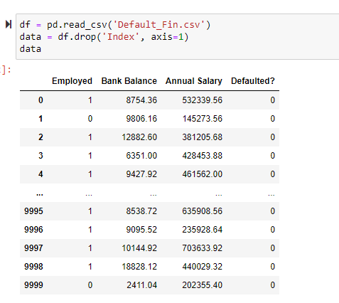
Data selection
For this problem, I want to acquire data of customers and their loans. The dataset I have selected is from Kaggle, ww.kaggle.com/kmldas/loan-default-prediction. Here’s the dataset:

Slide 4
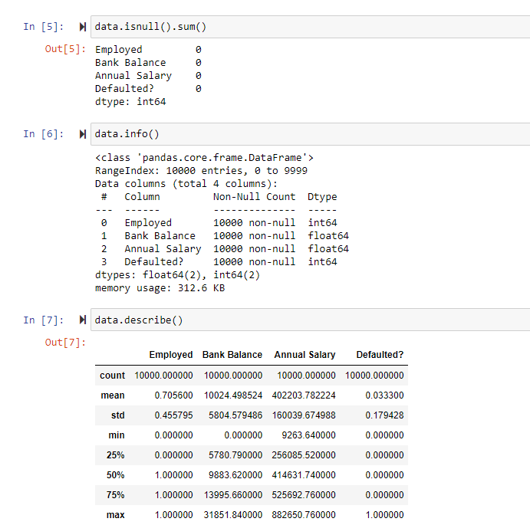
Data cleaning/data analysis
Null values, missing values, and the like were checked for in this step.
Model is split into training and test data, around 70/30 respectively.

Slide 5
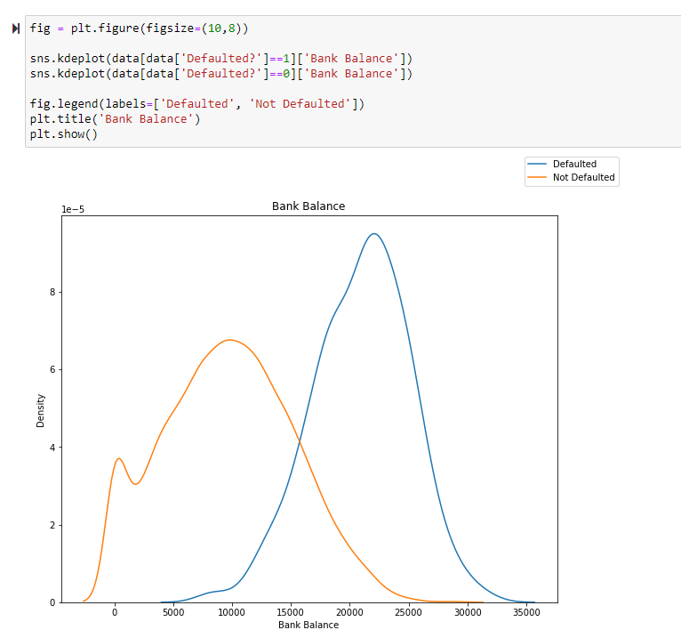
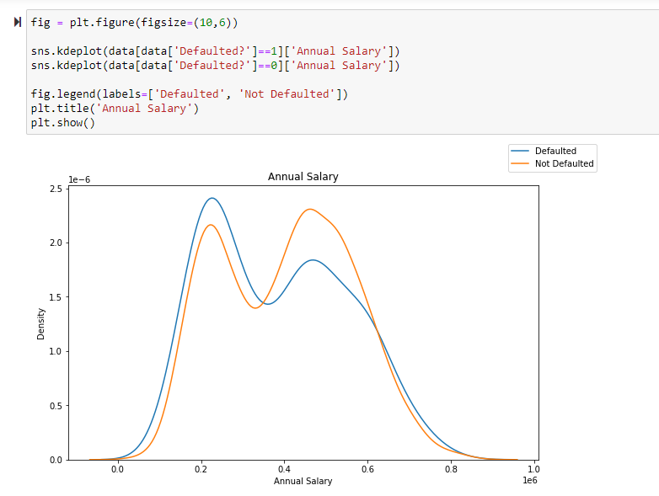
Preliminary analysis

Slide 6
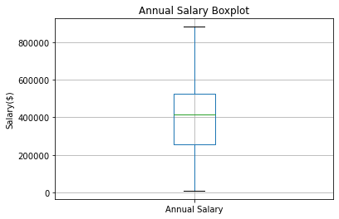
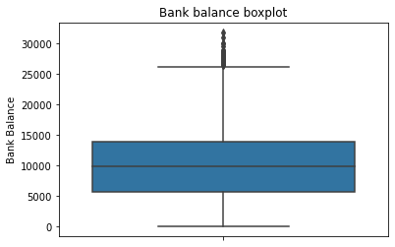
Preliminary analysis

Slide 7
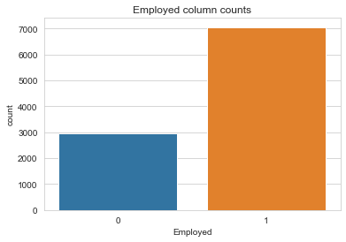
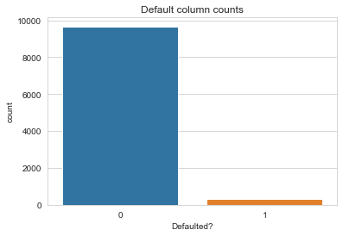
Preliminary analysis
During the preliminary analysis, it is realized that this dataset is unbalanced. This was expected since loans being in default would represent the minority outcome.
This is unbalanced because defaulted has more outcomes of not defaulted vs defaulted.
Unbalanced usually must be adjusted for. Thus, a technique called SMOTE was used.

Slide 8
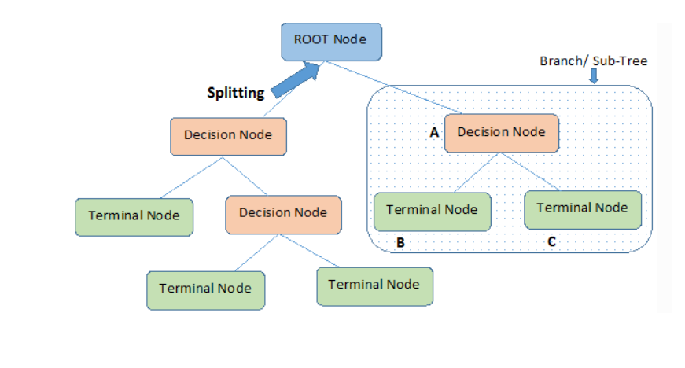
Model building- 3 approaches
Logistic Regression
Decision Tree-Here is a synopsis of what it looks like. It is a non-parametric model, which means there are no underlying assumptions.
This was chosen because the dependent variable has two outcomes, 0 and 1. This is how logistic regression is defined.

Slide 9

Model Approaches
Random Forest

Slide 10
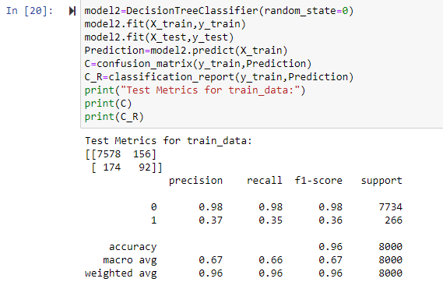
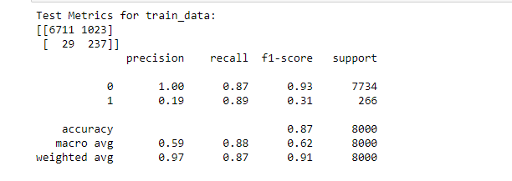
Models-Before adjustment for unbalanced data.
Decision tree-training data
Logistic regression-Training data

Slide 11
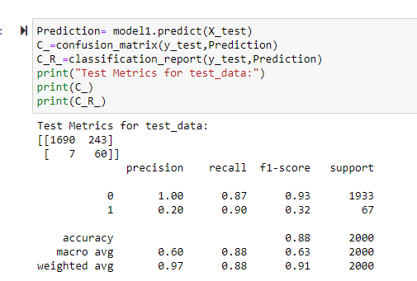
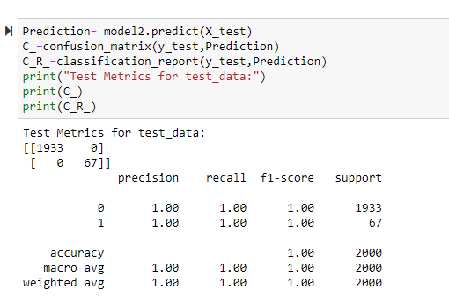
Models
Top-Logistic
Bottom- Decision Tree
Unbalanced and overfitting are a problem.

Slide 12
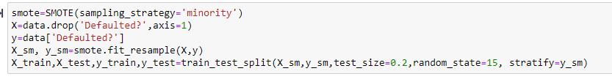
Adjusting the data
Unbalanced data is adjusted for via SMOTE. Further reading: https://machinelearningmastery.com/smote-oversampling-for-imbalanced-classification/

Slide 13
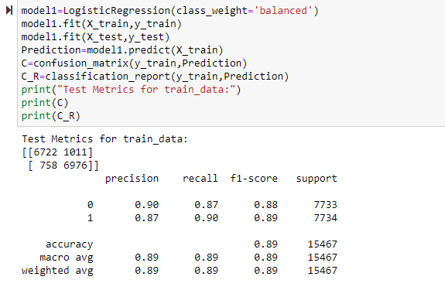
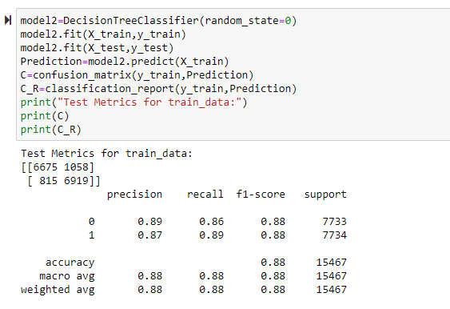
Models
Logistic
Decision Tree

Slide 14
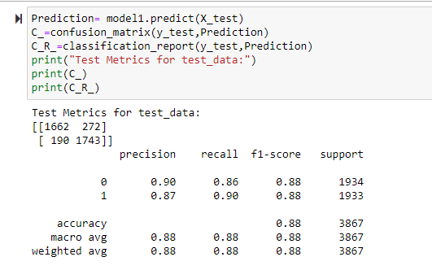
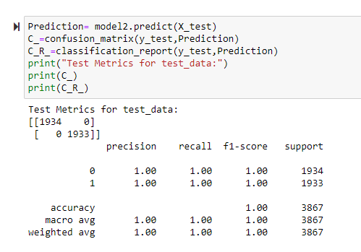
Models
Logistic-Test data
Decision Tree-Test Data

Slide 15
Overfitting!
Still a problem for the decision tree.
Thus…

Slide 16
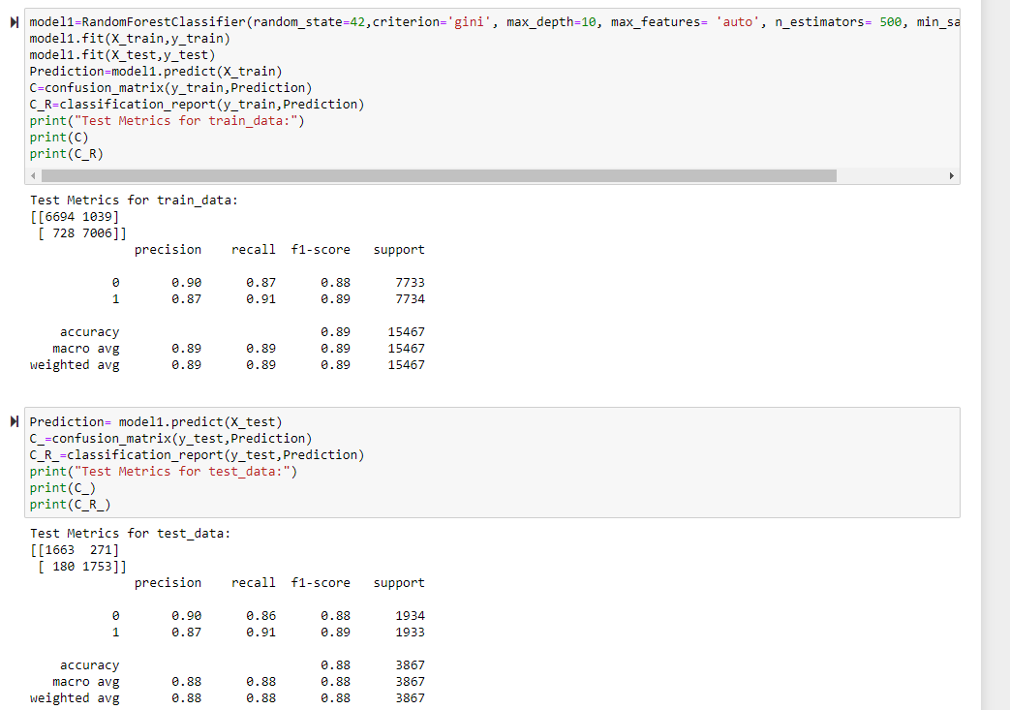
Random Forest Classifer!

Slide 17
Discussion
Overfitting and unbalanced data was a problem.
Precision and recall jumped significantly for the minority class(Yes for Defaulted?) when SMOTE was used.

Slide 18
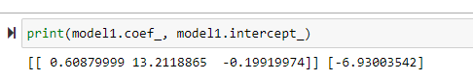
Discussion
The coefficients from the logistic model are-
Employed, Bank Balance, and Salary, left to right. We can see that Bank balance has decent influence.

Slide 19
Conclusions
Like the previous slide showed, we know that bank account balances are important. For example, a customer with a higher bank account balances wants a loan lending to them might be risky.

Slide 20
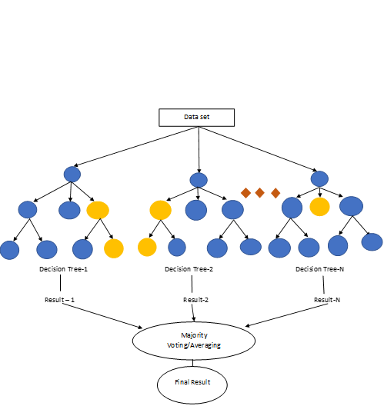
Conclusions
I wouldn’t put too much faith into the Decision Tree Classifier but the Random Forest Classifier performed well.

Slide 21
Acknowledgments
Acknowledgements
Predictive Analytics: The Power to Predict Who Will Click, Buy, Lie, or Die.
Applied Predictive Analytics: Principles and Techniques for the Professional Data Analyst

Slide 22
References
References
Brownlee, J. (2021, March 16). SMOTE for Imbalanced Classification with Python. Retrieved from https://machinelearningmastery.com/smote-oversampling-for-imbalanced-classification/
Chakure, A. (2020, November 06). Decision Tree Classification. Retrieved from https://medium.com/swlh/decision-tree-classification-de64fc4d5aac
Introduction to Random Forest in Machine Learning. (n.d.). Retrieved from https://www.section.io/engineering-education/introduction-to-random-forest-in-machine-learning/
Sklearn.ensemble.RandomForestClassifier. (n.d.). Retrieved from https://scikit-learn.org/stable/modules/generated/sklearn.ensemble.RandomForestClassifier.html

